Slide 1


Retention Analysis
DDS Analytics
Linda Eliasen

Slide 2
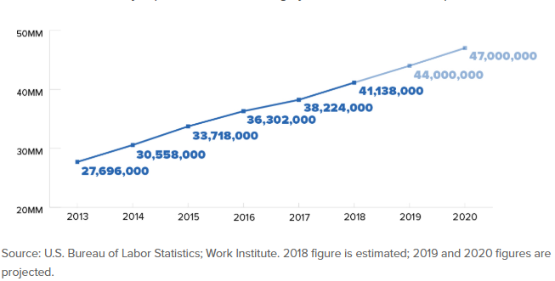
2018 Turnover
US Voluntary Turnover

Slide 3
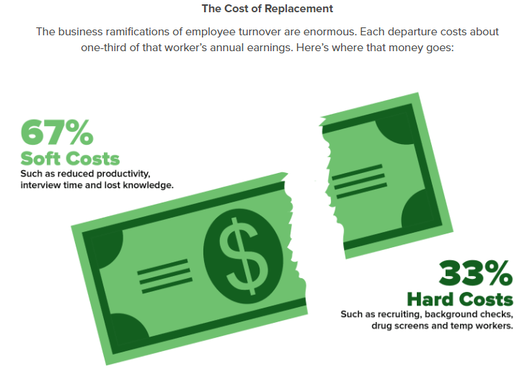
2018 Turnover
US total turnover for the Consumer Products industry was 21.5%.
Voluntary Turnover accounted for 16% of total separations
Frito-Lay’s combined voluntary turnover for HR, R&D and the Sales functions was 16%:
Sales 22%
Human Resources 17%
Research & Development 13%
Leading reasons why US employees left their jobs in 2018 (all industries)
Personal / Family 57%
Promotion Opportunity 35%
Career Change 27%
Base Salary 24%
Job Satisfaction 24%
Source: 2018 Mercer North America Turnover Survey

Slide 4
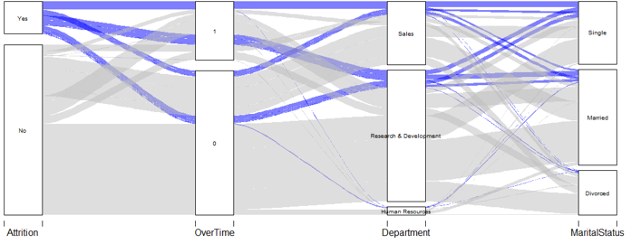
Attrition Trends

Slide 5
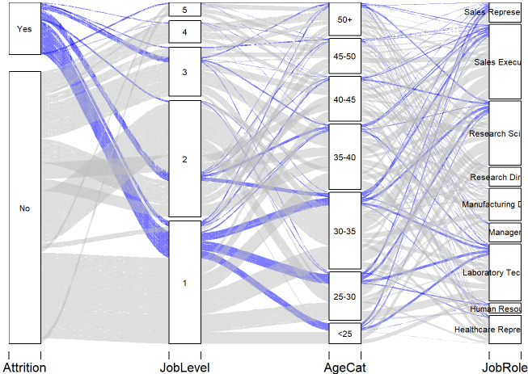
Attrition Trends

Slide 6
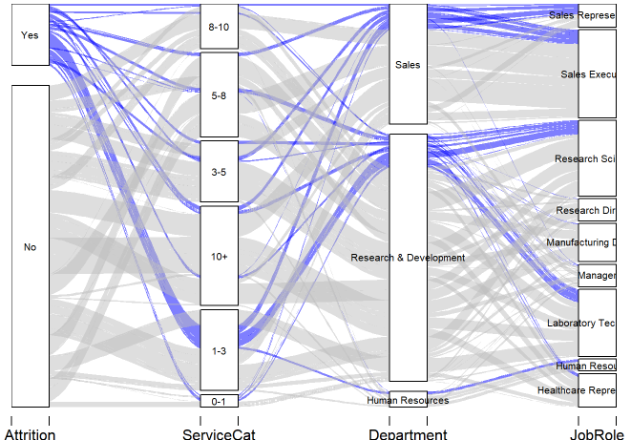
Attrition Trends

Slide 7
Departure Demographics
Less than 3 years of service
Entry level positions, within the Sales & R&D areas
Less then 30 years of age, primarily single

Slide 8
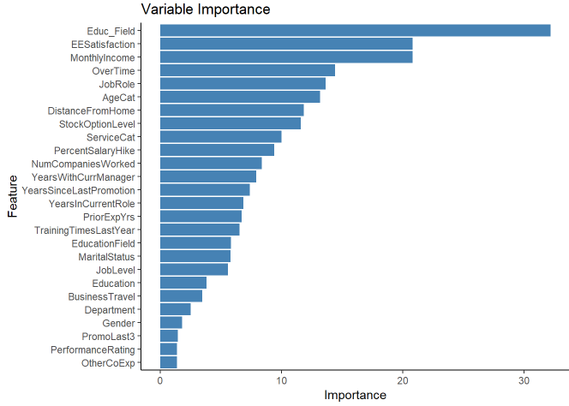
Predictors of Turnover
Education Level & Field of Study
Monthly Income
Employee Satisfaction

Slide 9
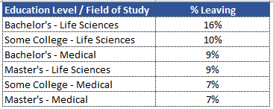
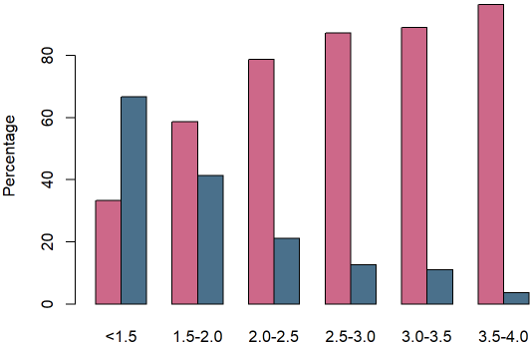
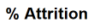
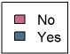
Predictors of Turnover
Life Sciences and Medical backgrounds are typical fields of study for R&D positions. As we saw earlier, there is a high attrition rate among Lab Techs and Research Scientists.
Employees with lower satisfaction scores left at higher rates than those who were more satisfied.

Slide 10
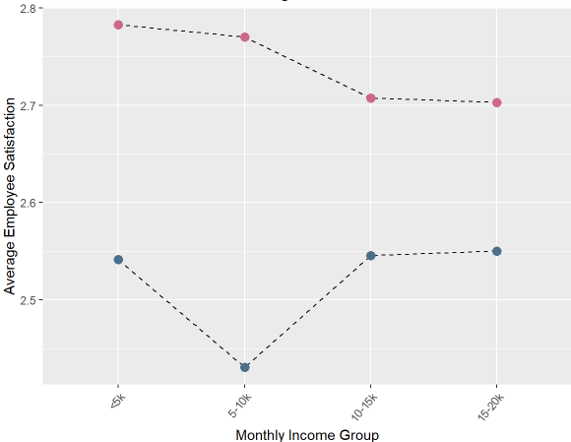
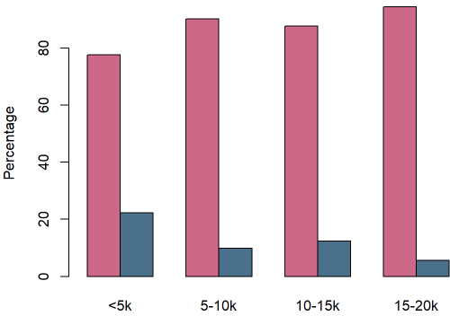
Predictors of Turnover

Slide 11
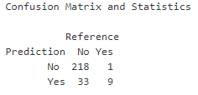
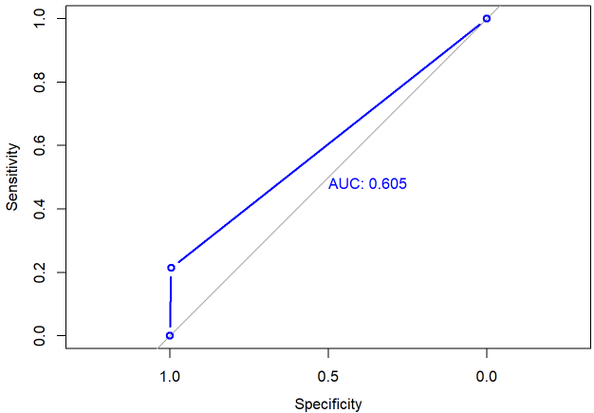
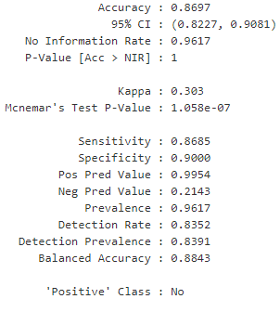
Predictive Modeling – Random Forest

Slide 12
Recommended Next Steps
Stay interviews to understand why employees stay and what might cause them to leave.
Re-evaluate the company’s on-boarding / integration process.
Conduct market data analysis to ensure salary ranges for job levels are market competitive.
Conduct focus groups with the Sales and R&D teams to better understand underlying issues.

Slide 13
Contact Information
DDS Analytics
Your Partner in all things data!
Linda Eliasen leliasen@mail.smu.edu
https://youtu.be/U9z4nmIYnBE

